Slide 1
How to Teach Computers to Recognize Things S4: Object Detection: Two Typical Computer Vision AI Application: OCR + Face detection
Dr. Du Pengfei
SVS/DMD
18 July 2024

Slide 2
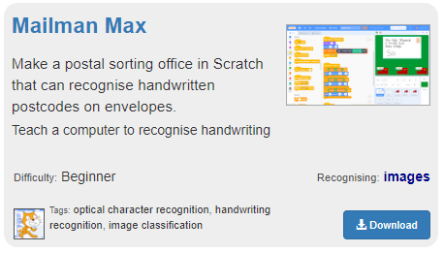
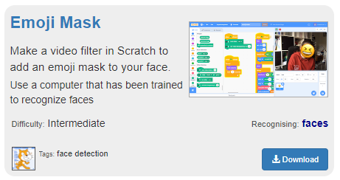
Agenda
Aim: Hands-on Experience of Typical AI applications on Recognizing Things
First Hands-on Project: Handwriting Recognition
Second Hands-on Project: Face Detection
Optical Character Recognition (OCR)
Handwriting Recognition

Slide 3

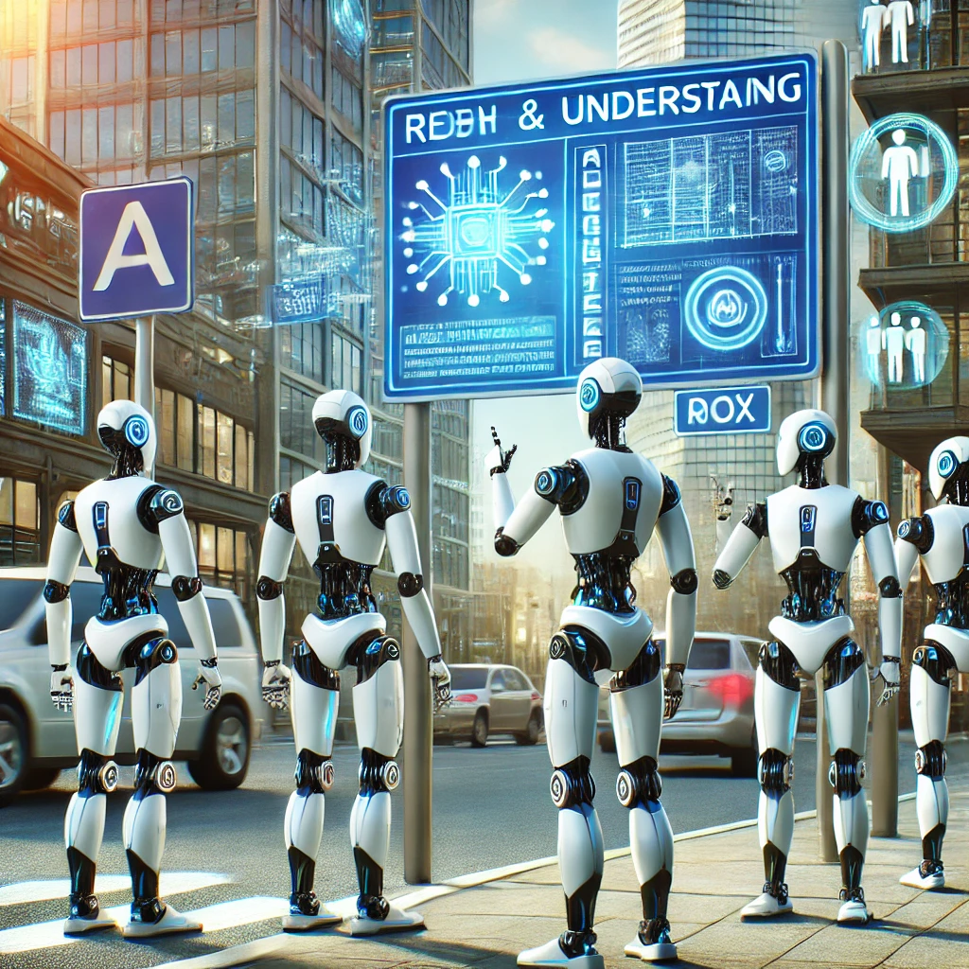

OCR: Optical Character Recognition
Primary Goal: let robots and computers convert handwriting/printed characters from images to editable digital characters.
Ultimate Goal: let robots and computers understand what we have typed or written using cameras.

Slide 4
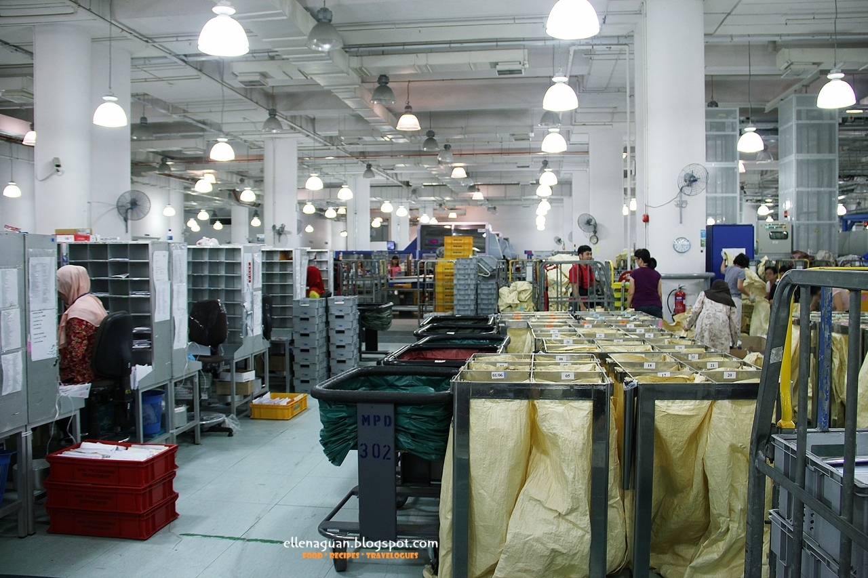
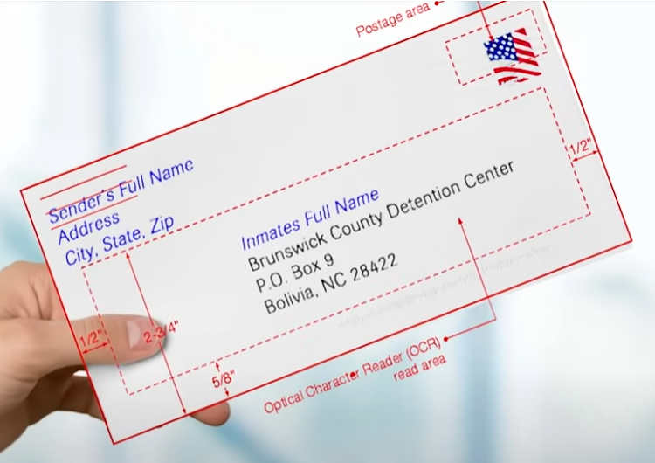
AI-OCR helps to reduce workload of mailman
OCR Project: Mailman Max

Slide 5
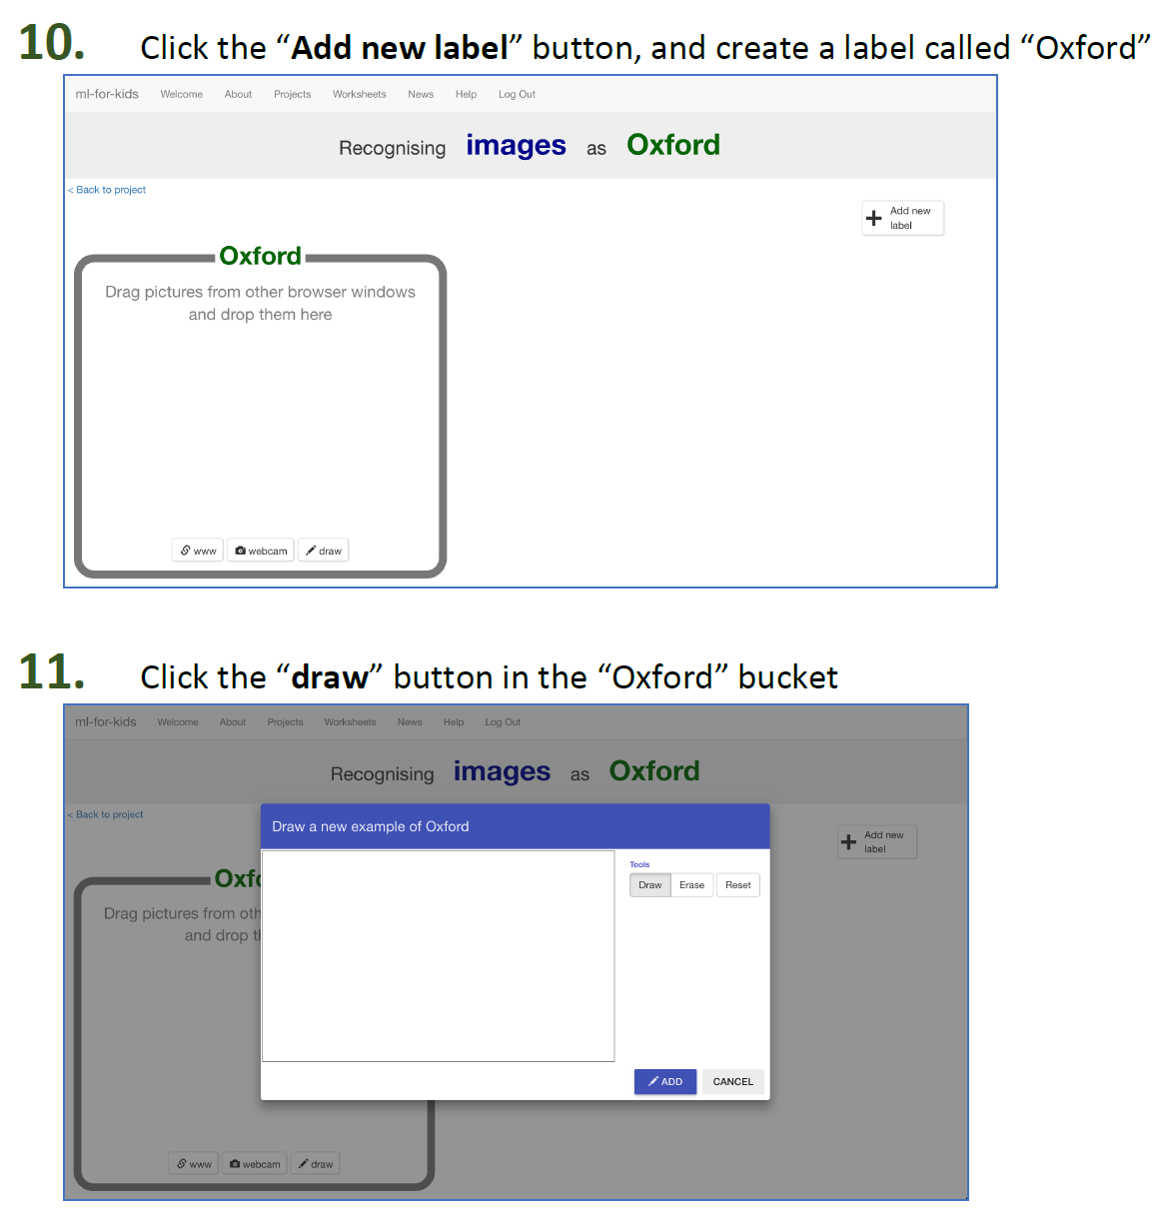
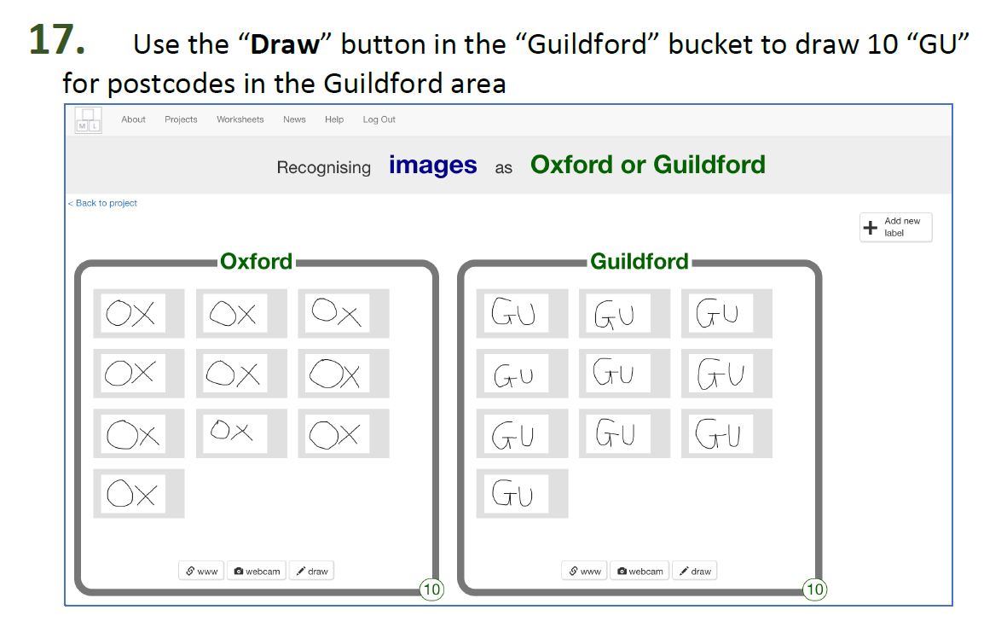
OCR Project: Mailman Max
Bear in Mind while conducting your AI Project:
Is Data sufficient for training?
Is Data of high quality including all scenarios without bias?

Slide 6
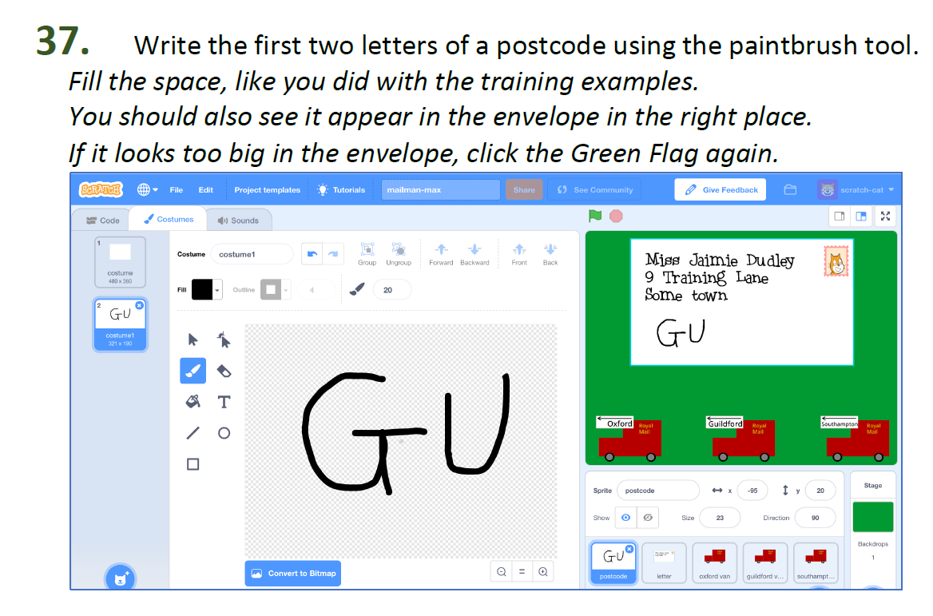
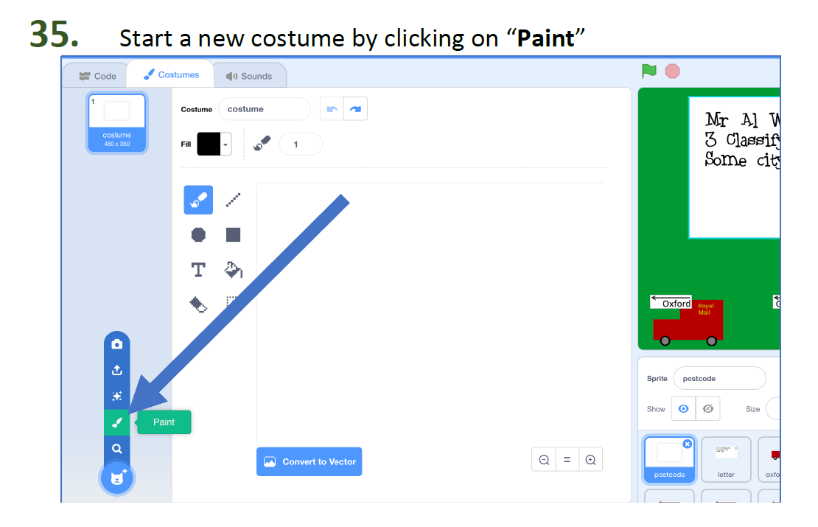
OCR Project: Mailman Max
Bear in Mind while conducting your AI Project:
Is Data sufficient for training?
Is Data of high quality including all scenarios without bias?

Slide 7
Let’s Start with Project Mailman Max

Slide 8
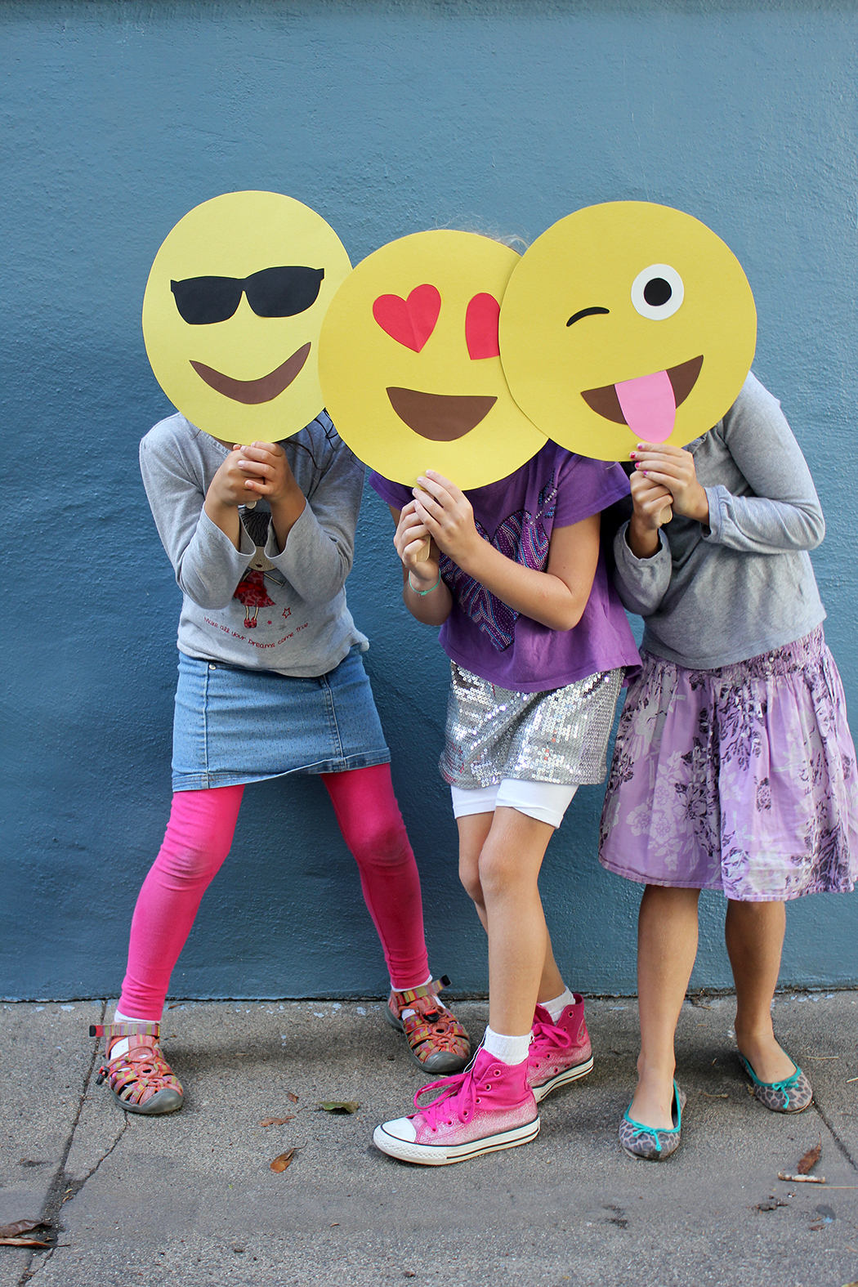
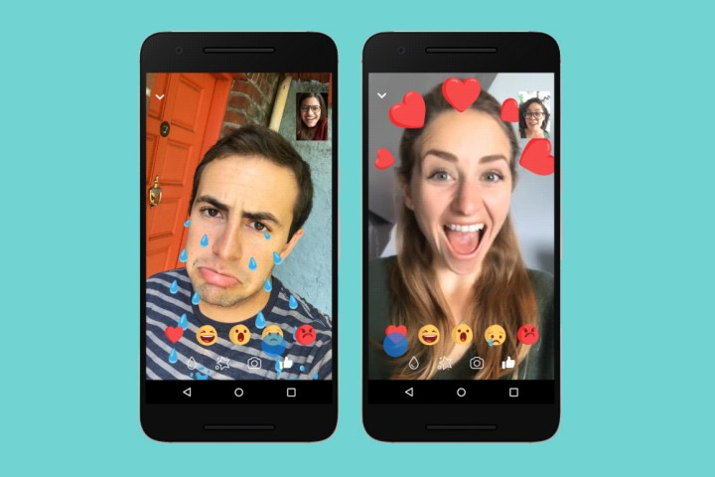
Object/Face Detection: Project Emojimask
Make a video face filter in Scratch that adds an emoji mask to your face.
AI Special Effects

Slide 9
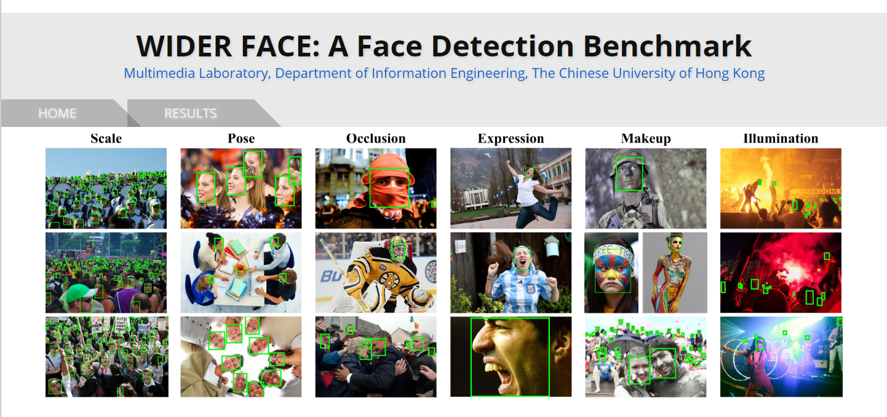
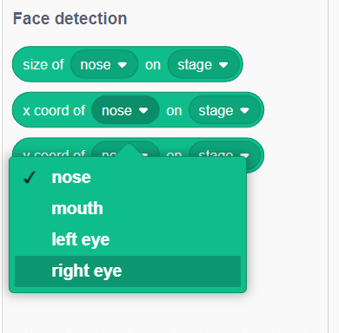
Object/Face Detection: Project Emojimask
Principle: Object Detection Specialized in Face Components
Pretrained Model used in Our Project:

Slide 10
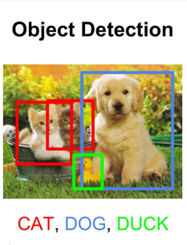
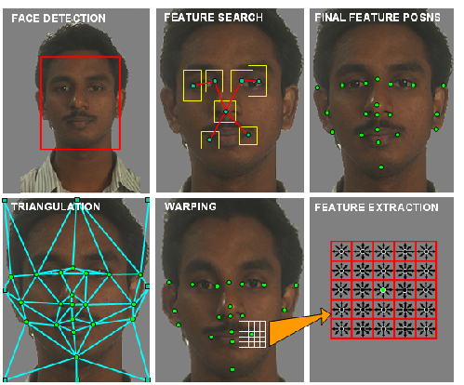
Object/Face Detection: Project Emojimask
Principle: Object Detection Specialized in Face Components
Object Detection
Face Detection
Face Key-Points Detection

Slide 11
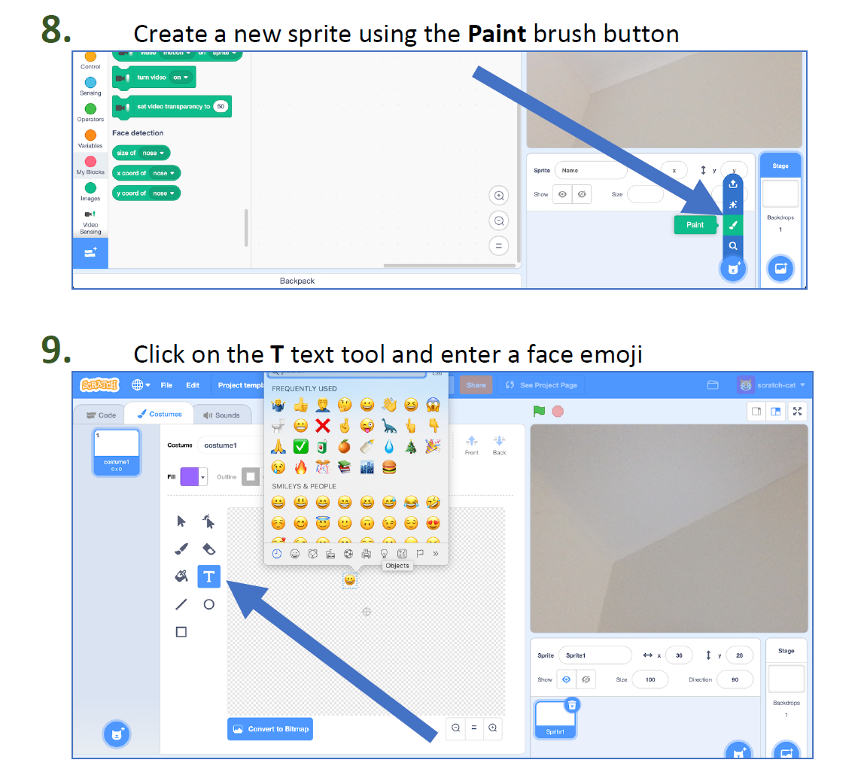
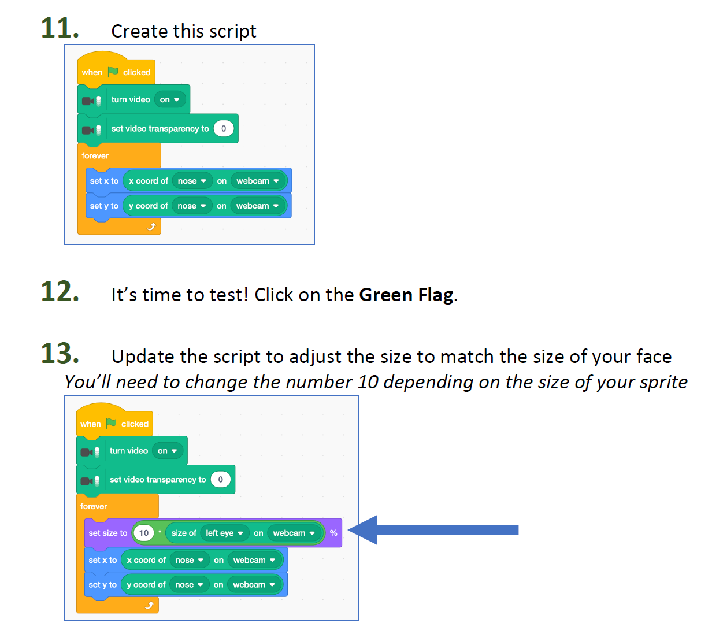
Object/Face Detection: Project Emojimask

Slide 12
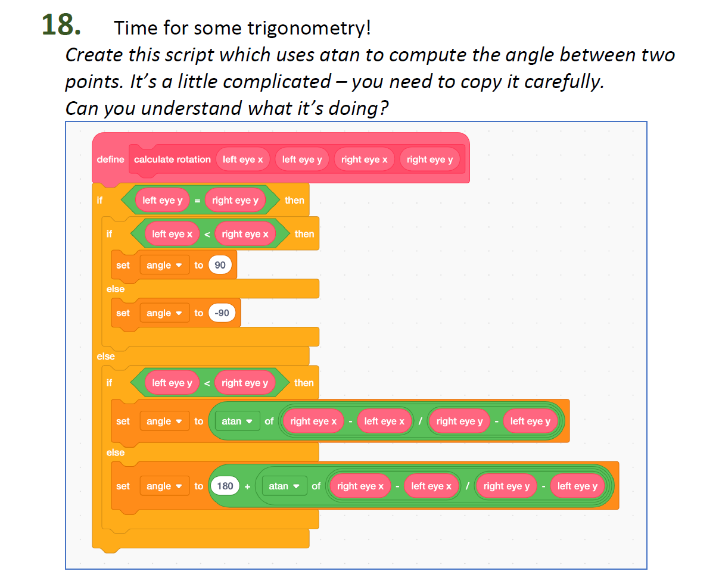
Object/Face Detection: Project Emojimask

Slide 13
Object/Face Detection: Project Emojimask

Slide 14
Let’s Start with Project Emojimask

Slide 15
Contact: Du Pengfei
du_pengfei@SIMTech.a-star.edu.sg

